Slide 1
Software - Architecture Fundamentals
By
Asif Hasan

Slide 2


Software Architecture
Architectural design is concerned with understanding how a software system should be organized and designing the overall structure of that system.
Software Architecture is how the defining components of a software system are organized and assembled. How they communicate each other. And how the constraints of the whole system is ruled by.
The architectural model serves as a input to the development phase.

Slide 3
Advantages of explicit architecture
Stakeholder communication
  Architecture may be used as a focus of discussion by system stakeholders.
System analysis
  Means that analysis of whether the system can meet its non-functional requirements is possible.
Large-scale reuse
  The architecture may be reusable across a range of systems

Slide 4

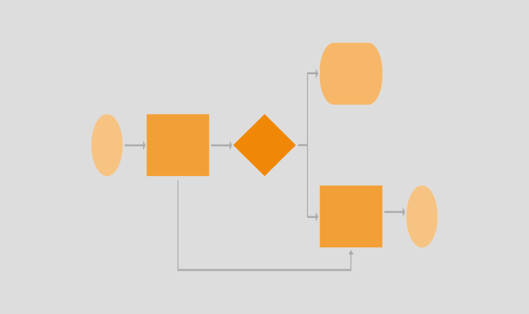
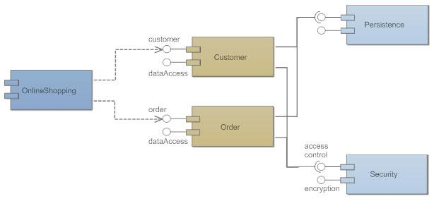
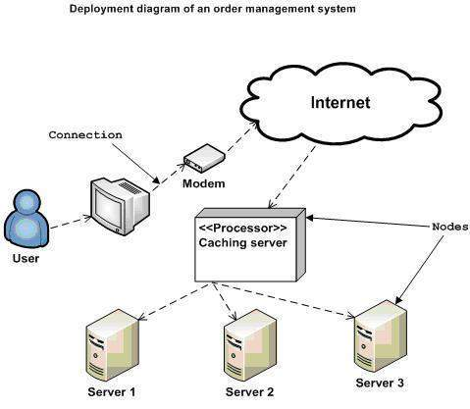
4 + 1 view model of software architecture
A logical view, which shows the key abstractions in the system as objects or object classes. (class/state diagrams)
A process view, which shows how, at run-time, the system is composed of interacting processes. (activity diagram)
A development view, which shows how the software is decomposed for development. (Component/package diagram)
A physical view, which shows the system hardware and how software components are distributed across the processors in the system. (Deployment diagram.)
Related using use cases or scenarios (+1)

Slide 5

MVC Pattern
MVC goes for Model-View-Controller Pattern
Separates presentation and interaction from the data handling logic.
The system is structured into three logical components that interact with each other- Model, View and Controller

Slide 6

Model
View
[4] Get Presentation of the product data
[5] Returns the presentation with dynamic rendering
[2] Get the product data from DB
[3] Fetch the data and return to controller
[1] Request: Get a product
Controller
Routes
[6] Returns the response

Slide 7
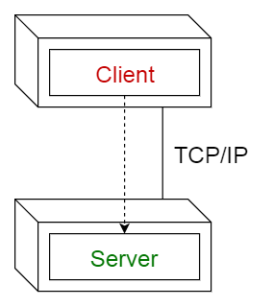
Client-server pattern
This pattern consists of two parties; a server and multiple clients.
The server component will provide services to multiple client components.
Clients request services from the server and the server provides relevant services to those clients.
Furthermore, the server continues to listen to client requests.
Set of stand-alone servers which provide specific services such as printing, data management, etc.
Set of clients which call on these services.
Network which allows clients to access servers.

Slide 8
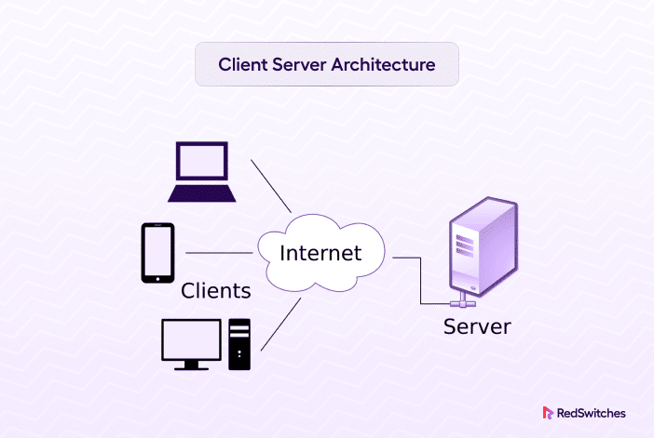

Slide 9
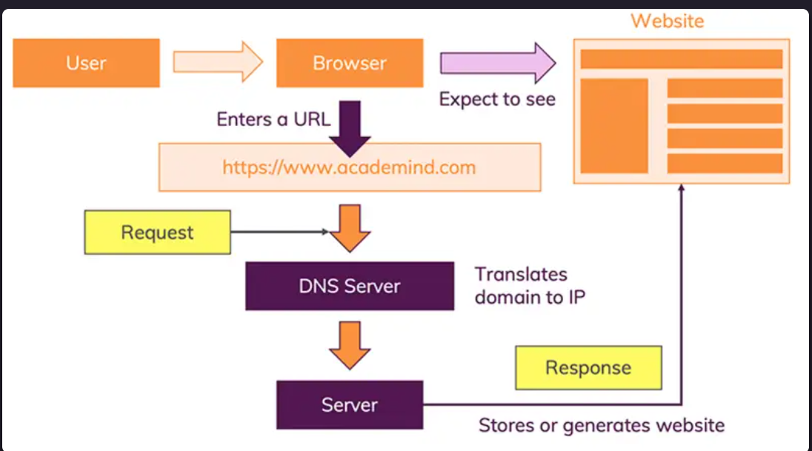

Slide 10

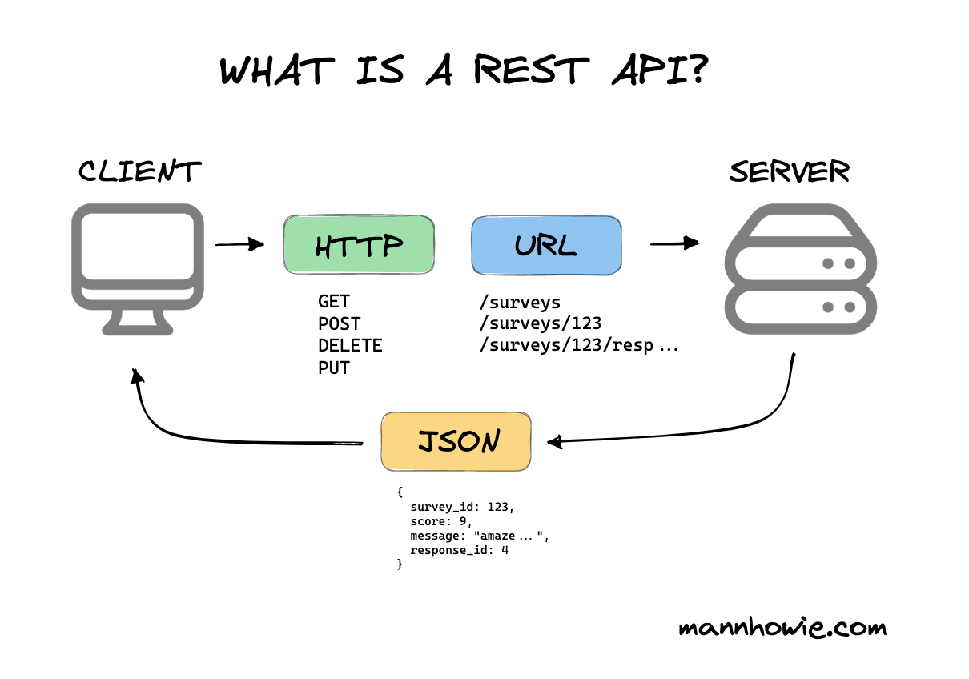

Slide 11
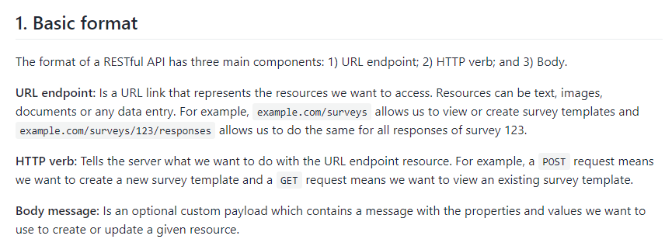

Slide 12
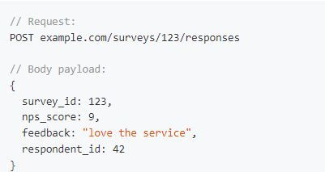

Slide 13
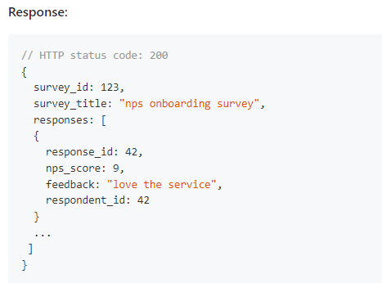

Slide 14
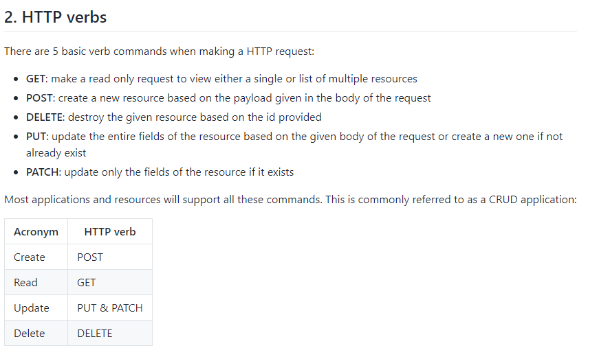

Slide 15
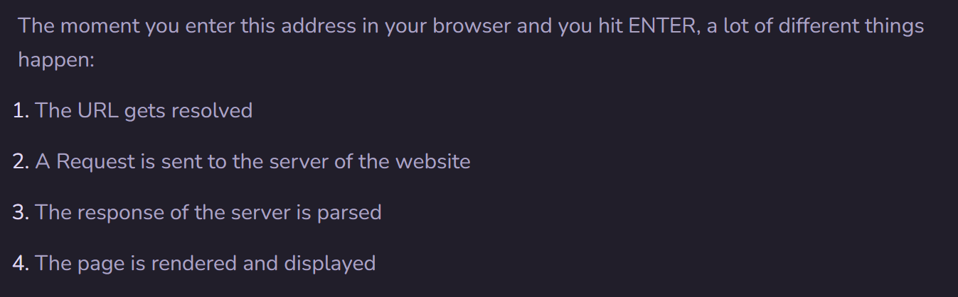
Website Working process in Steps

